Slide 1
Sinhgad College of Engineering Department of Information Technology
Project Review
on
“Emotion Recognition System
using Facial Expressions”
By
Group No.: AB5
Roll No | Name
407020 | Rugved Chaudhary
407007 | Mahesh Auti
407026 | Ankul Gupta
407038 | Deval Sonkusare
Guide
“Mrs. R. S. Sonar”

Slide 2
Outline
Project area
Motivation
Aim
Objective
Problem Statement
Hardware & Software Requirements
Problems / Gaps found in the existing system
Literature Survey
Scope of the project
UML diagrams
References
11-12-2017
SCOE, Information Technology (2017-18)
2
Notes:
2

Slide 3
Emotion Recognition System
using Facial Expressions
Project Area
Web Application
Image Processing
Machine Learning
11-12-2017
SCOE, Information Technology (2017-18)
3
Notes:
3

Slide 4
Motivation
To take a step forward in the field of artificial intelligence and image processing applications.
To minimise efforts in managing large playlists.
There is no commonly used application which is able to play songs based on the current emotions of the user.
11-12-2017
SCOE, Information Technology (2017-18)
4
Notes:
4

Slide 5
Aim
The aim of this project is to develop an application which will Detect the facial expressions such as : Happy, Sad, Stressed, surprised.
The application will have a rich interface which attracts music lovers to get engaged within the app itself.
11-12-2017
SCOE, Information Technology (2017-18)
5
Notes:
5

Slide 6
Objective
Determine the facial expressions such as : Happy, Sad, Stressed, surprised.
Build an application (Music Player) to present the proposed model.
Enhance human machine interactions
11-12-2017
SCOE, Information Technology (2017-18)
6
Notes:
6

Slide 7
Problem Statement
The state of mind and current emotional mood of human beings can be easily observed through their facial expressions.
Recognise the facial expressions with highest possible accuracy and build an application to implement system.
11-12-2017
SCOE, Information Technology (2017-18)
7
Notes:
7

Slide 8
Hardware & Software Requirements
Software Requirements
Windows 7/8/8.1/10 or Linux based operating system.
Web browser
OpenCV
ISED(Indian Software Expression Database)
Hardware Requirements
Webcam
11-12-2017
SCOE, Information Technology (2017-18)
8
Notes:
8

Slide 9
Problems/Gaps found in existing system
Inefficient Human Machine interaction .
Time Consumption in search of a suitable song .
Trouble of creating and managing playlists
11-12-2017
SCOE, Information Technology (2017-18)
9
Notes:
Unfortunately, previous work has shown that a full semantic approach to this problem cannot be applied, therefore statistical methods are required.
Acc to our knowledge there is software called CodeBhagat for .net is present .
9

Slide 10
Literature Survey
Most efficient way to detect and localize the face in an Image : Histogram of oriented gradients(HOG) + SVM
Way to Extract features from image: Facial landmarks with dlib, OpenCV, and Python
Classification Algorithm to detect the emotion
11-12-2017
SCOE, Information Technology (2017-18)
10
Notes:
Natural Language Processing and Programming Languages are both established areas in the field of Computer Science, each of them with a long research tradition. Python was created at the end of 1980s.
Python has a clean grammar and syntax. It’s natural and fluent. Certain data will be stored in the form of graphs so that it can be retrieved easily using SPARQL queries.
Finding a mapping between natural language and web programming language is important. If we know how to convert natural language questions into their associated SPARQL queries, it would be straightforward to obtain the answers by just executing a query.
NLTK is a leading platform for building Python programs to work with human language data. It provides easy-to-use interfaces to over 50 corpora and lexical resources such as WordNet, along with a suite of text processing libraries for classification, tokenization, stemming, tagging, parsing, and semantic reasoning, wrappers for industrial-strength NLP libraries, and an active discussion forum
10

Slide 11
Citations
Sr. No. | Title | Author | Description
1 | Face recognition using Histograms of Oriented Gradients | O. Déniz, G. Bueno, J. Salido, F. De la Torre b | This paper explores the use of HOG features for face recognition.
2 | Emotion Classification through Lower Facial Expressions using Adaptive Support Vector Machines | Porawat Visutsak | This paper describes the emotion classification through lower facial expressions using the A SVMs.
3 | One Millisecond Face Alignment with an Ensemble of Regression Trees | Vahid Kazemi and Josephine Sullivan | described how an ensemble of regression trees can be used to regress the location of facial landmarks from a sparse subset of intensity values extracted from an input image.
11-12-2017
SCOE, Information Technology (2017-18)
11
Notes:
11

Slide 12
Scope of project
Human Robot Interaction
To detect drink and drive
To Help people who are going through depression.
Suggest music therapy for mood enhancement
11-12-2017
SCOE, Information Technology (2017-18)
12
Notes:
12

Slide 13
UML diagrams
Use case diagram
Class diagram
Sequence diagram
Activity diagram
Dataflow Diagram
11-12-2017
SCOE, Information Technology (2017-18)
13
Notes:
13

Slide 14
Use case diagram
11-12-2017
SCOE, Information Technology (2017-18)
14
Notes:
14

Slide 15
Class diagram
11-12-2017
SCOE, Information Technology (2017-18)
15
Notes:
15

Slide 16
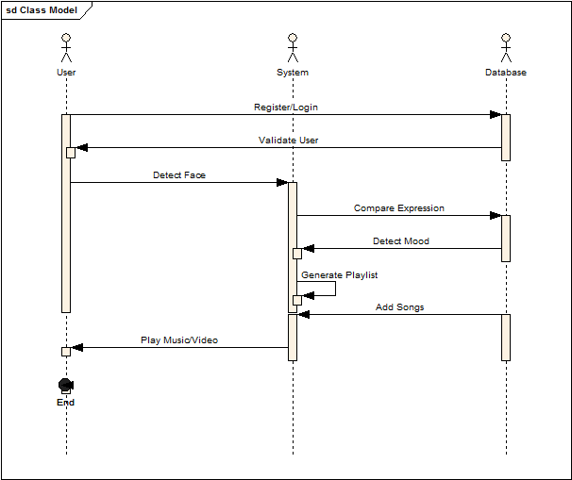
Sequence diagram
11-12-2017
SCOE, Information Technology (2017-18)
16
Notes:
16

Slide 17
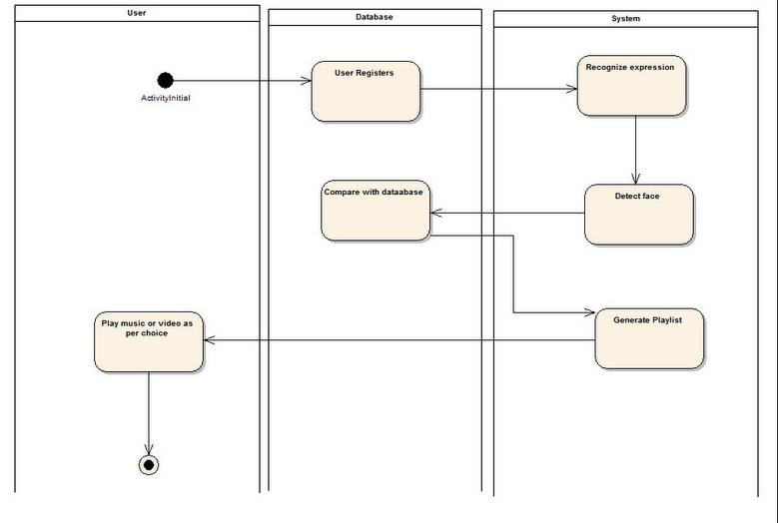
Activity diagram
11-12-2017
SCOE, Information Technology (2017-18)
17
Notes:
17

Slide 18
Block Diagram
Image/Image Dataset
Face Detection
Feature Extraction
Playlist of songs
Detected mood
SVM Classifier
11-12-2017
SCOE, Information Technology (2017-18)
18
Notes:
18

Slide 19
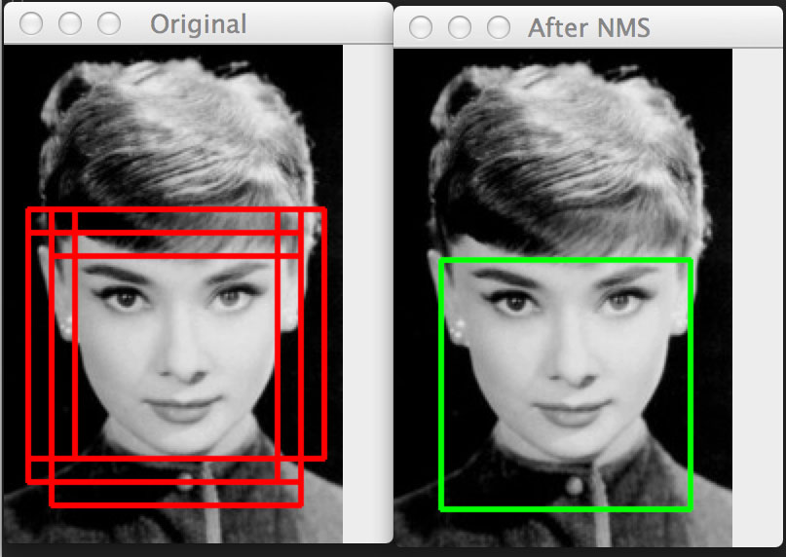
Face detection
Histogram of Oriented Gradients (HOG) image descriptor
+
Linear Support Vector Machine (SVM)

Slide 20
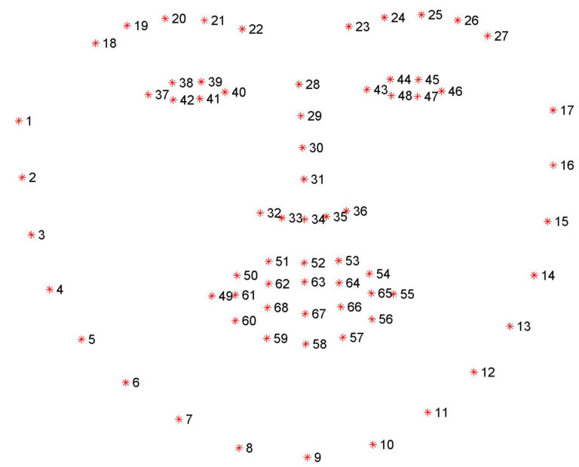
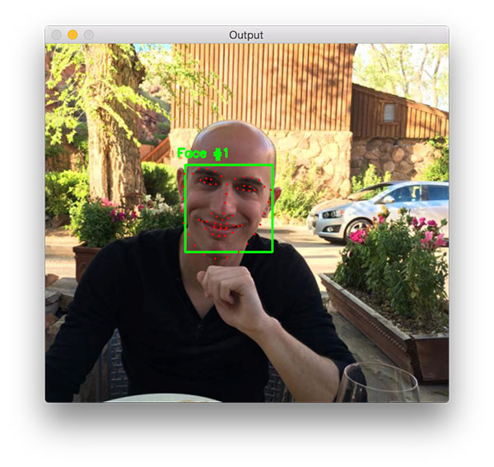
Feature Extraction
Facial Landmark detection using Libraries Dlib and OpenCv

Slide 21
SVM Classifier
Training Phase
Assigining expression/emotion values
+1 for happy
+2 for neutral
+3 for sad
Testing Phase

Slide 22
References
Face recognition using Histograms of Oriented GradientsO. Déniz, G. Bueno, J. Salido, F. De la Torre Universidad de Castilla-La Mancha, E.T.S. Ingenieros Industriales, Avda. Camilo Jose Cela s/n, 13071 Ciudad Real, Spain Carnegie Mellon University, Robotics Institute, 211 Smith Hall, 5000 Forbes Ave., Pittsburgh, PA 15213, USA Pattern Recognition Letters 32 (2011) 1598–1603
Emotion Classification through Lower facial Expressions using Adaptive Support Vector Machines, Porawat Visutsak, Department of Information Technology, Faculty of Industrial Technology and Management, King Mongkut’s University of Technology North Bangkok, porawatv@kmutnb.ac.th
One Millisecond Face Alignment with an Ensemble of Regression Trees, Vahid Kazemi and Josephine Sullivan KTH, Royal Institute of Technology Computer Vision and Active Perception Lab Teknikringen 14, Stockholm, Sweden {vahidk,sullivan}@csc.kth.se .

